Slide 1


Slide 2
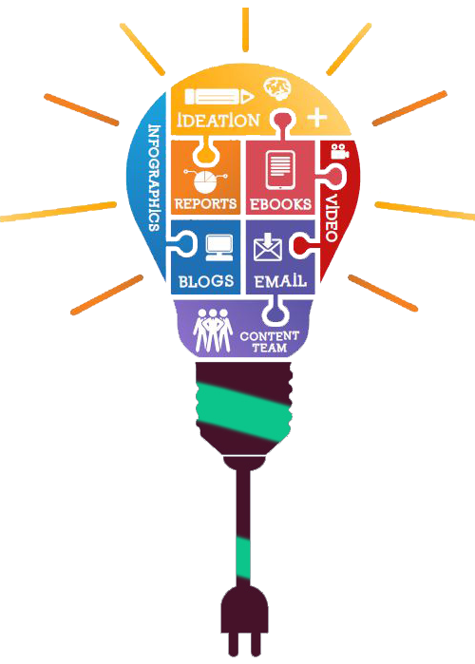
Content Marketing
Essentials

Slide 3
Content marketing is a strategic marketing approach focused on creating and distributing valuable, relevant content to attract and engage a target audience
What is Content Marketing?
Definition
Goal
Drive profitable customer action through valuable content

Slide 4
Importance of Content Marketing
Builds Brand Awareness
Quality content increases visibility and recognition
Establishes Authority
Sharing expertise fosters trust and positions your brand as a thought leader
Enhances SEO
Valuable content can improve search rankings and organic traffic
Nurtures Customer Relationships
Engaging content keeps your audience informed and connected

Slide 5
Types of Content
Blog Posts
Informative articles that address customer pain points or interests
Videos
Engaging visual content that can explain complex topics easily
Infographics
Visual representations of data and information that are easy to digest
Podcasts
Audio content that allows for in-depth discussions and storytelling
Social Media Posts
Short, engaging updates that promote content and encourage interaction

Slide 6
Basics of Copywriting
What is copywriting?
The art of writing persuasive content to motivate the audience to take action
Key Principles
Know Your Audience
Understand their needs and preferences
Clear Call to Action (CTA)
Direct the reader on what to do next (e.g., "Subscribe," "Buy Now")
Engaging Headlines
Capture attention and encourage clicks
Storytelling
Create relatable narratives that connect with readers

Slide 7
Creating a Content Strategy
Steps to Develop a Content Strategy
Define Your Goals
What do you want to achieve? (e.g., increase traffic, generate leads)
Identify Your Target Audience
Create buyer personas to tailor content to their needs
Choose Content Types
Determine which formats resonate with your audience (e.g., blog posts, videos)
Content Calendar
Plan topics, publish dates, and formats in advance for consistent output

Slide 8
Content Distribution Channels
Where to Share Your Content
Website/Blog
Central hub for your content
Social Media
Platforms like Facebook, Instagram, LinkedIn, and Twitter to reach a wider audience
Email Newsletters
Directly reach your audience’s inbox with valuable updates
Guest Blogging
Publish on other sites to expand your reach and authority

Slide 9
Measuring Content Marketing Success
Key Metrics to Track
Traffic
Number of visitors to your content
Engagement
Likes, shares, comments, and time spent on the page
Conversions
Actions taken by users (e.g., sign-ups, purchases)
SEO Performance
Keyword rankings and organic traffic growth

Slide 10
Content Marketing Best Practices
Consistency is Key
Regularly publish content to maintain audience engagement
Focus on Quality Over Quantity
Prioritize creating valuable content over producing a large volume
Adapt and Optimize
Use analytics to refine your strategy and improve content over time

Slide 11
Discussion Questions
What types of content do you find most engaging and why?
(Encourage students to reflect on what draws their attention as consumers)
Have you encountered any brands with particularly effective content marketing strategies?
(Encourage discussion of standout brands and their content strategies)

Slide 12


Slide 13


